Slide 1
Section 1.4
Fair division

Slide 2
Fair division
Fair division is the concept of dividing something among 2 or more people in such a way that each person finds his/her share to be fair.
Division doesn’t mean to be equal; they need to be fair in the eye of the beholder.

Slide 3
The divider-chooser method
It is a practical and simple approach to having two people share an object than can be cut into pieces.

Slide 4
Example
Let's say that there are three people trying to divide a cake. The lone divider cuts the cake in equal parts.
The other two people (the "choosers") get to determine which share is fair for them.
If they choose different parts, the division is simple: each one gets the share he/she choses, while the divider ends up with the remaining part.
Since for the divider every share is fair, everyone is satisfied.

Slide 5
The Adjusted Winner Procedure
It is a method by which two parties can divide a group of items in a fair manner, provided one of the items can be divided.

Slide 6
Example
Suppose Bob and Carol are getting a divorce and must divide up some of their assets. We assume that they distribute 100 points among the five items as follows:
Item | Carol | Bob
Retirement Account | 50 | 40
Home | 20 | 30
Summer Cottage | 15 | 10
Investments | 10 | 10
Other | 5 | 10
Total | 100 | 100

Slide 7
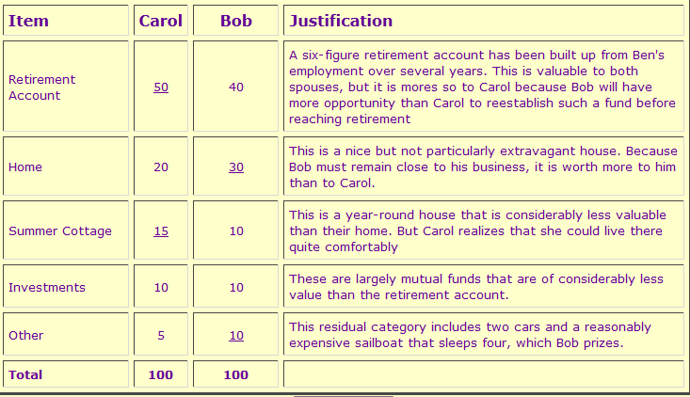
Cont’…

Slide 8
The method of sealed bids
Each person writes down the highest amount they would be willing to pay for each item secretly.
The highest bidder for each item will win it, and the other people will be compensated with money, paid to them by the person who won the item. Bidders are not compensated directly. Instead, if there are n bidders, the winner will place
(n-1)/n * (the winning bid) into a kitty.
For example, if there are 4 bidders, the winner places ¾ of his bid into the kitty.
The non-winners will take then 1/nth of their individual bids from the kitty. “ (1/n)*non-winners bid amount”
After each non-winner has taken the appropriate amount from the kitty, the remaining funds in the kitty are then divided equally among each bidder, including the one who won the item.

Slide 9
Example
Clark Kent and Lois Lane are no longer going to live together, but they have decided who will get to keep their dog. Obviously, they wont be able to divide the dog, and they do not want to sell it, either. So they will use the secret sealed bid method.
Clark bids $400 for the dog
Lois bid $600 for the dog
Since this division involved 2 people, each of them is entitled to ½ of the value of their bid.
Lois is the higher bidder, will get the dog, and she will have to put ½ of her bid, 300, into the kitty.
Clark takes ½ of his bid from the kitty, $200, from the kitty.
This leaves 100 in the kitty, which is split evenly between the two people. So each will take $50 more from the kitty.
That means, to be fair, Lois gets the dog and pays $250 to Clark.

Slide 10
Example
For students to try.

Slide 11
Example
There is unseen film about Star Wars from Episode IV. No one has seen this before except for the directors and the actors. Three friends found it. Now they decided to use the secret ballot bid method.
James bids $6000
Kirk bids $ 4200
Tiberius bids $5100
Find who gets what?
James pays-$3700
Kirk gets $1700
Tiberius gets $2000

Slide 12
Hw Section 1.4 pg 59
1,5-8, a,b

